Slide 1
CREDIT RISK PREDICTION
Anupriya Kushwanshi
ON GERMAN CREDIT DATASET
Source: http://archive.ics.uci.edu/ml/datasets/Statlog+(German+Credit+Data)

Slide 2
OBJECTIVE
To predict if a customer is going to be a credit defaulter or not:
It is worse to class a customer as good when they are bad (5), than it is to class a customer as bad when they are good (1).
Notes:
FN- more research on person

Slide 3
APPROACH for supervised learning
Exploratory Data Analysis
Train and test split
Logistic Regression Model
Original model
Stepwise Variable selection
5:1 Asymmetric cost function
Decision Tree Model
Confusion Matrix (In sample)
Comparison of models
Structure
Histogram
Frequency plot
75% train
25% test
In sample
Out of sample
Bagging
Boosting
Random Forest
ROC
Area under the curve

Slide 4
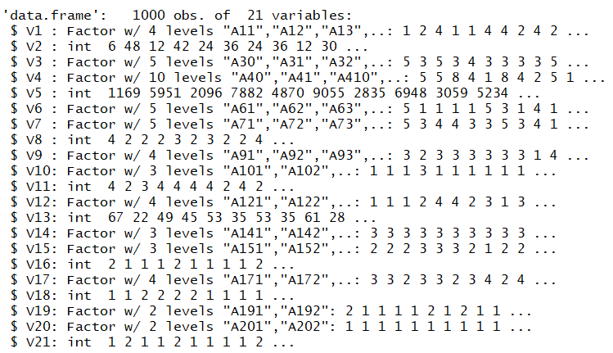
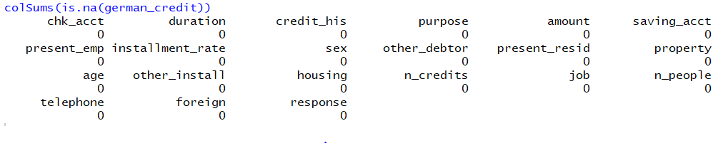
ORIGINAL STRUCTURE

Slide 5
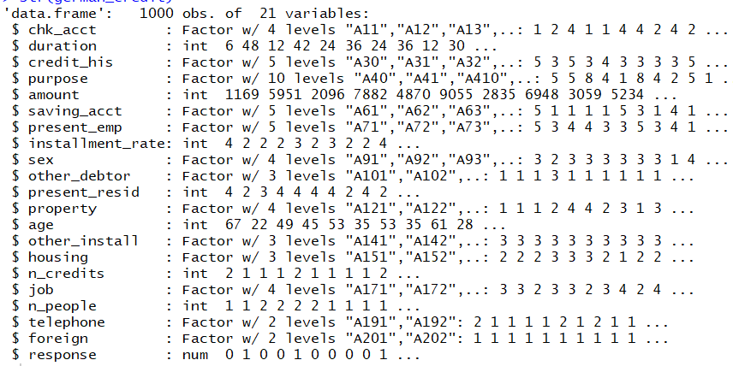
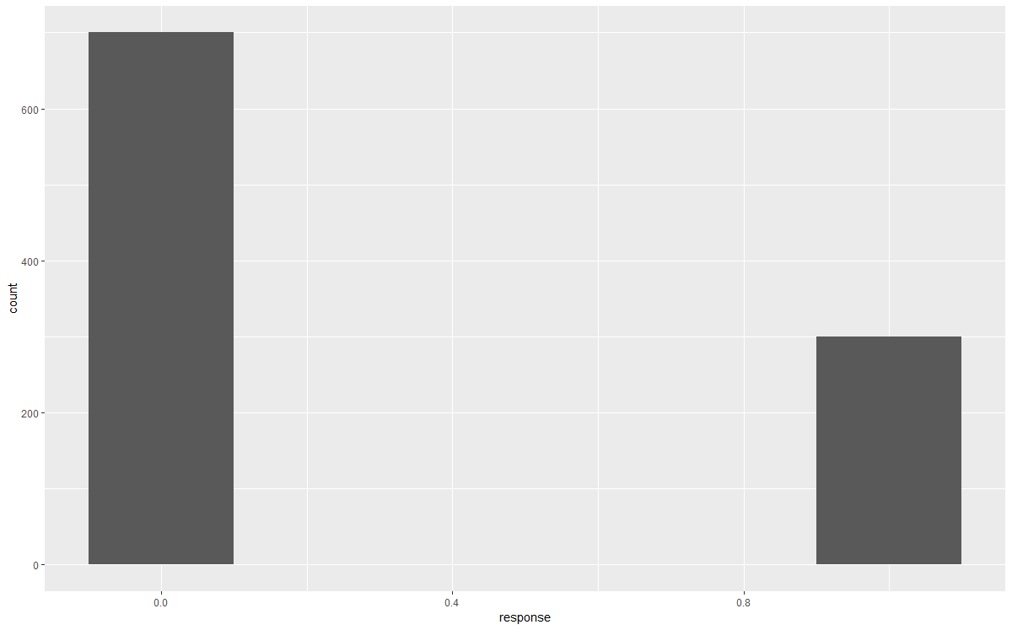
Restructured Data & Class Distribution
Notes:
Original class distribution

Slide 6
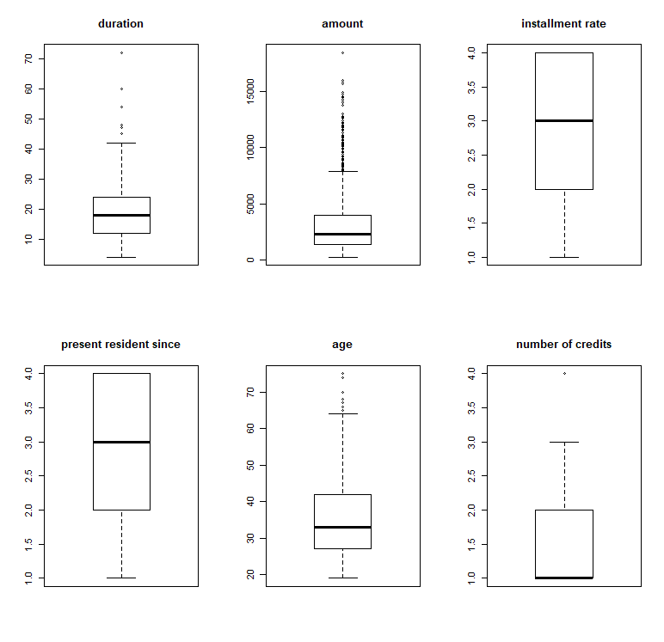
OUTLIER DETECTION

Slide 7
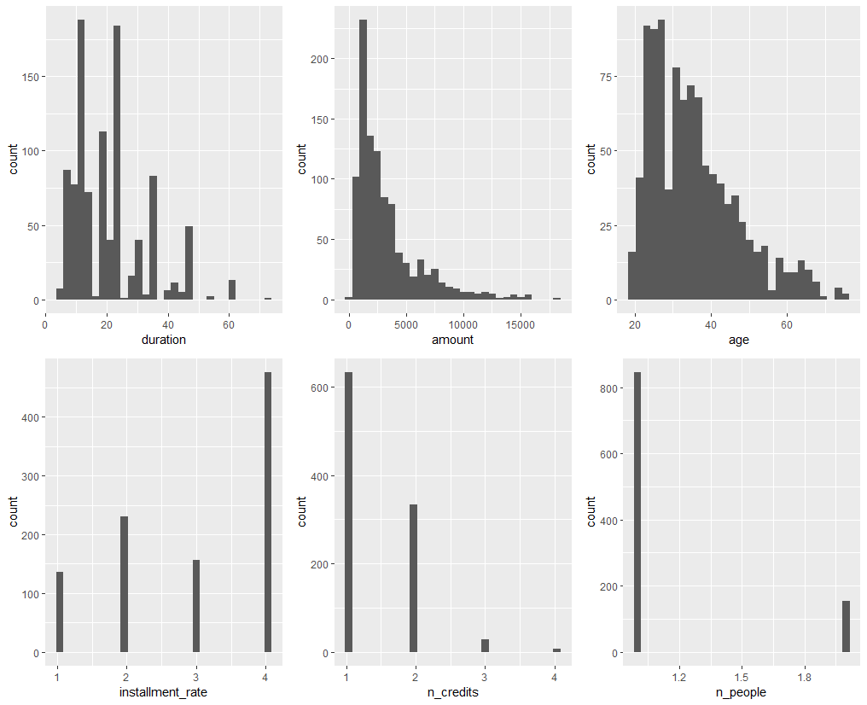
QUANTITATIVE VARIABLE HISTOGRAMS
Notes:
Removing outliers -> losing information

Slide 8
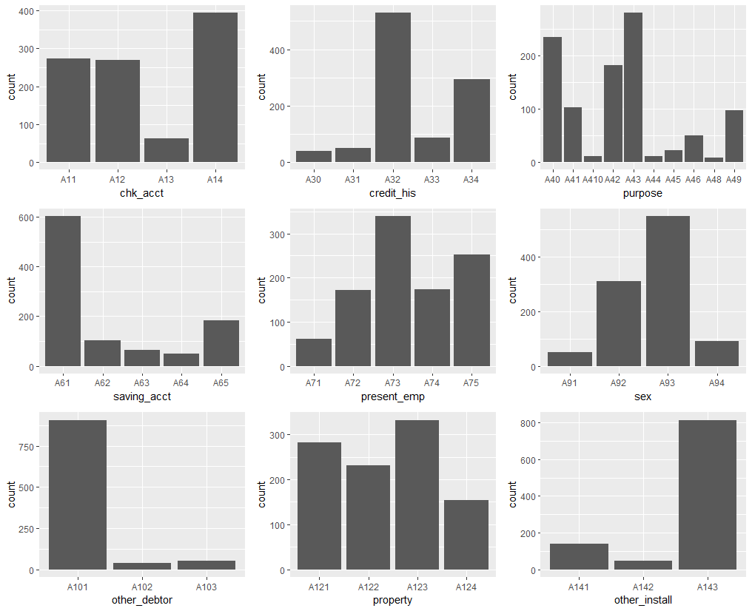
CATEGORICAL VARIABLE FREQUENCY PLOTS
40% people don’t have checking account
55% customers paid back existing credit
Most common purposes are car and TV/radio
60% people have less than 100DM
55% customers are single males
93% customers have no guarantors
80% customers have no other installment plans

Slide 9
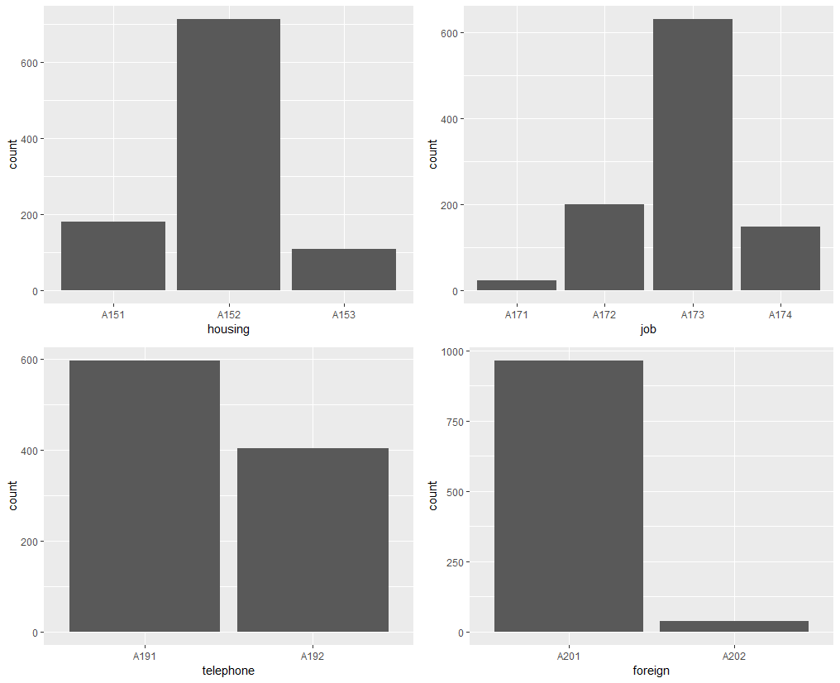
CATEGORICAL VARIABLE FREQUENCY PLOTS
70% customers own houses
65% customers are skilled employees
95% employees are foreign workers

Slide 10
LOGISTIC MODEL – PREDICTION AND MR
Original | Pred
True | 0 | 1
0 | 143 | 33
1 | 38 | 36
Step | Pred
True | 0 | 1
0 | 149 | 31
1 | 34 | 36
train$response ~ chk_acct + duration + purpose + credit_his + saving_acct + other_install + foreign + installment_rate + present_emp + amount + telephone
Logistic Regression Model | Train prediction error | Test prediction error | AIC
Full model | 0.21 | 0.284 | 760.7796
Stepwise | 0.23 | 0.26 | 744.0806
Notes:
Feature selection

Slide 11
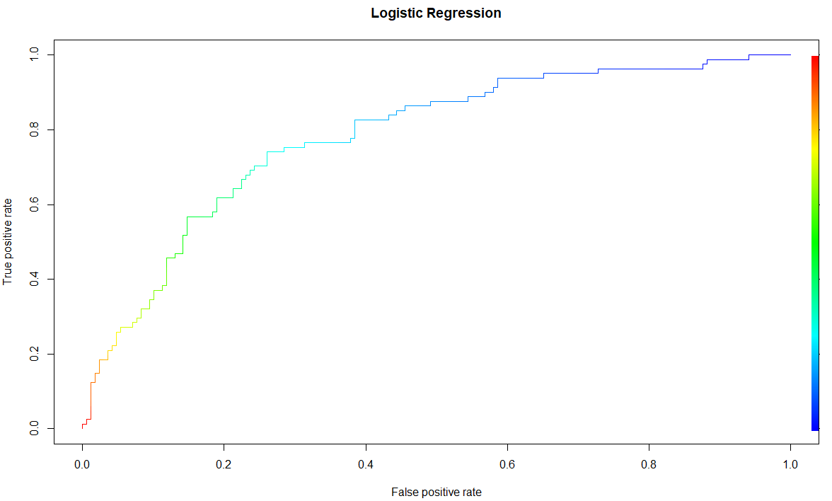
Receiver Operating Characteristic(ROC) curve
Model | AUC
Stepwise | 0.78

Slide 12
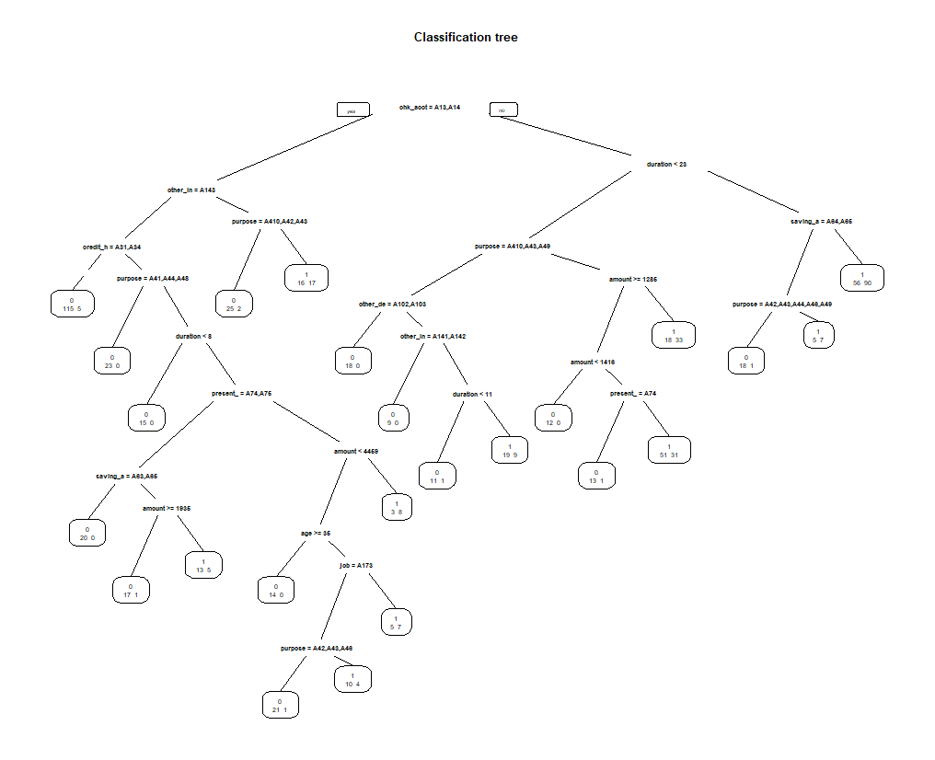
Original decision tree
Notes:
Tree – picks up every noise and it can overfit very easily, computationally expensive
Entropy of each split criteria – least entropy

Slide 13
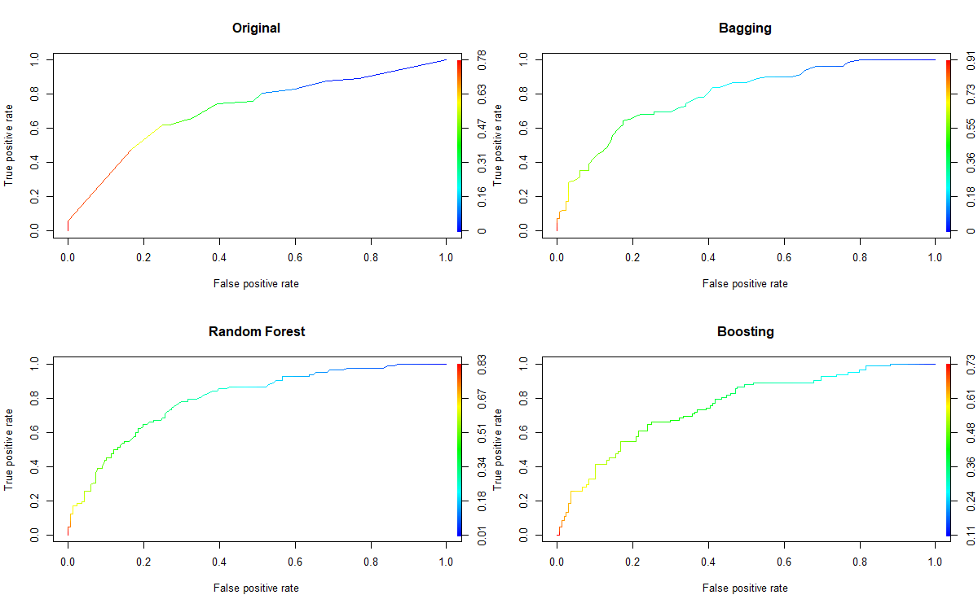
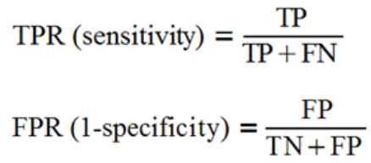
Receiver Operating Characteristic(ROC) curvefor trees
Model | AUC
Original | 0.71
Bagging | 0.79
Random Forest | 0.79
Boosting | 0.75
Notes:
Ensemble methods

Slide 14
Misclassification Rate & Prediction Error
Original | Pred
True | 0 | 1
0 | 91 | 89
1 | 14 | 56
Bagging | Pred
True | 0 | 1
0 | 144 | 36
1 | 33 | 37
Random Forest | Pred
True | 0 | 1
0 | 120 | 60
1 | 23 | 47
Decision tree model | Train prediction error | Test prediction error
Original tree | 0.30 | 0.41
Bagging tree | 0.25 | 0.27
Random forest | 0.33 | 0.33
Boosting tree | 0.00 | 0.26
Boosting | Pred
True | 0 | 1
0 | 148 | 29
1 | 36 | 37

Slide 15
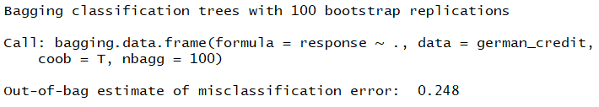
Final Model Selection
Model | Train prediction error | Test prediction error
Logistic Regression | 0.23 | 0.26
Decision tree | 0.25 | 0.27
Bagging | Pred
True | 0 | 1
0 | 144 | 36
1 | 33 | 37
Step | Pred
True | 0 | 1
0 | 149 | 31
1 | 34 | 36

